Slide 1
PROGRAMING AND
DEVELOPMENT
For Students

Slide 2







Describe
PROGRAMING AND
DEVELOPMENT
For Students
Nature of Programming
Different languages
Explore
App development

Slide 3
flutter
TOPICS
Nature of Programming
Different languages
Explore
App development

Slide 4


flutter
1. What is the nature of programming?
Nature of Programming
Programs must be written for people to read, and only incidentally for machines to execute.“
— Harold Abelson, computer scientist and author.
It is both an art and a science, requiring creativity, logic, and problem-solving skills. Programming translates human ideas into a language that machines can understand, enabling the development of software, and applications, solve problems and providing solutions across various domains
Understanding how to analyze, create and focus on programming

Slide 5
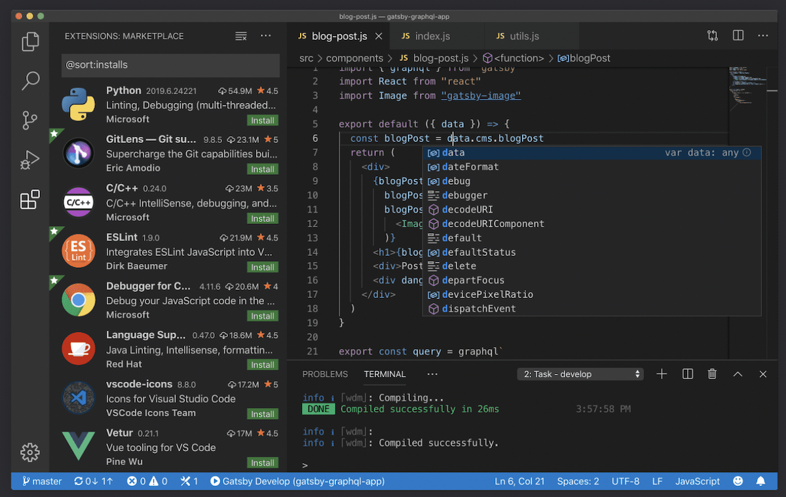
flutter
1. What is the nature of programming?
Nature of Programming
Programs must be written for people to read, and only incidentally for machines to execute.“
— Harold Abelson, computer scientist and author.
It is both an art and a science, requiring creativity, logic, and problem-solving skills. Programming translates human ideas into a language that machines can understand, enabling the development of software, and applications, solve problems and providing solutions across various domains

Slide 6
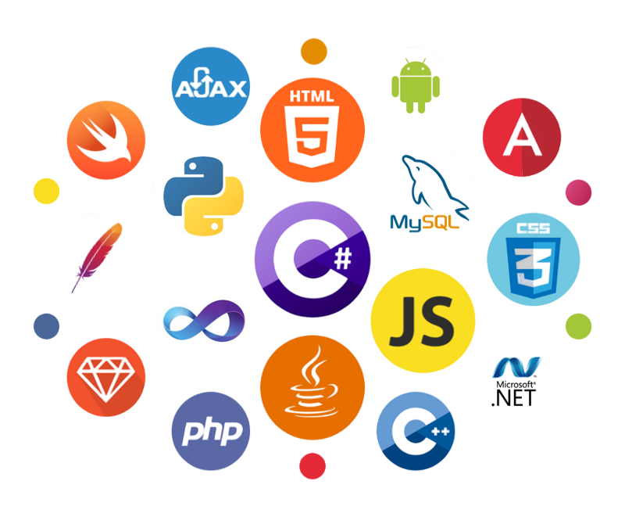

flutter
1. Why there are different languages?
<\>
Simplicity vs Complexity:
Simplicity focuses on clear and straightforward designs, making things easier to use and understand. Complexity involves more features and intricacy, which can add depth but may also increase difficulty.

Slide 7









<\>
Historical Evolution:
<\>
Languages evolved differently in various regions due to geographical, social, and cultural separations, leading to the development of distinct languages over time
Historical Evolution:
Languages evolved differently in various regions due to geographical, social, and cultural separations, leading to the development of distinct languages over time
Designed for business data processing and administrative systems.
client-side web development, enabling interactive and dynamic websites.
client-side web development, enabling interactive and dynamic websites.
1950s
1980s
2000s
Assembly:
C++ :
C# :
1960s
1990s
2010s
COBOL :
JAVASCRIPT :
PYTHON :
Used for low-level hardware control and system programming.
an extension of c, adding object-oriented features, and popular for software development
Developed by Microsoft, primarily used for Windows application development and enterprise software.

Slide 8

<\>
Adaptation and Innovation
Different languages offer diverse ways of thinking and expressing ideas, which can lead to innovation and a rich exchange of concepts across cultures.
C
Personality: Efficient, performance-oriented, enjoys low-level programming, detail-focused.
Interest: Ideal for students interested in system programming, embedded systems, and understanding how software interacts with hardware. C provides foundational knowledge and skills useful for developing operating systems, drivers, and real-time applications.

Slide 9




<\>
Adaptation and Innovation
Different languages offer diverse ways of thinking and expressing ideas, which can lead to innovation and a rich exchange of concepts across cultures.
Dart
JAVASCRIPT
Go (Golang)
PYTHON
Julia
TypeScript
Personality: Innovative, enjoys clean and structured code, adaptable.
Interest: Ideal for students interested in cross-platform mobile and web app development, particularly with the Flutter framework, which allows for a single codebase across different platforms.
Personality: Creative, enjoys visual work, and fast-paced environments.
Interest: Ideal for those interested in web development, creating interactive websites, or working on both front-end and back-end development.
Personality: Efficient, enjoys simplicity and performance, solution-oriented.
Interest: Great for those interested in system-level programming, cloud services, and microservices architecture, with a focus on building scalable and efficient software.
Personality: Curious, adaptable, enjoy simplicity.
Interest: Those who like to experiment, solve problems, and work across diverse fields like web development, data science, and AI.
Personality: Analytical, enjoys numerical computing and performance.
Interest: Perfect for students interested in data science, scientific computing, and mathematical modeling, especially where high performance and easy syntax are desired.
Personality: Organized, values type safety, enjoys large-scale development.
Interest: Ideal for students interested in building scalable web applications with strong type-checking, particularly those who work on both front-end and back-end development in JavaScript environments.

Slide 10
<\>
Adaptation and Innovation
Different languages offer diverse ways of thinking and expressing ideas, which can lead to innovation and a rich exchange of concepts across cultures.
Dart
JAVASCRIPT
Go (Golang)
PYTHON
Julia
TypeScript
Personality: Innovative, enjoys clean and structured code, adaptable.
Interest:Ideal for students interested in cross-platform mobile and web app development, particularly with the Flutter framework, which allows for a single codebase across different platforms.
Personality: Creative, enjoys visual work, and fast-paced environments.
Interest: Ideal for those interested in web development, creating interactive websites, or working on both front-end and back-end development.
Personality: Efficient, enjoys simplicity and performance, solution-oriented.
Interest: Great for those interested in system-level programming, cloud services, and microservices architecture, with a focus on building scalable and efficient software.
Personality: Curious, adaptable, enjoy simplicity.
Interest: Those who like to experiment, solve problems, and work across diverse fields like web development, data science, and AI.
Personality: Analytical, enjoys numerical computing and performance.
Interest: Perfect for students interested in data science, scientific computing, and mathematical modeling, especially where high performance and easy syntax are desired.
Personality: Organized, values type safety, enjoys large-scale development.
Interest: Ideal for students interested in building scalable web applications with strong type-checking, particularly those who work on both front-end and back-end development in JavaScript environments.

Slide 11
<\>
Adaptation and Innovation
Different languages offer diverse ways of thinking and expressing ideas, which can lead to innovation and a rich exchange of concepts across cultures.
Dart
JAVASCRIPT
Go (Golang)
PYTHON
Julia
TypeScript
Personality: Innovative, enjoys clean and structured code, adaptable.
Interest:Ideal for students interested in cross-platform mobile and web app development, particularly with the Flutter framework, which allows for a single codebase across different platforms.
Personality: Creative, enjoys visual work, and fast-paced environments.
Interest: Ideal for those interested in web development, creating interactive websites, or working on both front-end and back-end development.
Personality: Efficient, enjoys simplicity and performance, solution-oriented.
Interest: Great for those interested in system-level programming, cloud services, and microservices architecture, with a focus on building scalable and efficient software.
Personality: Curious, adaptable, enjoy simplicity.
Interest: Those who like to experiment, solve problems, and work across diverse fields like web development, data science, and AI.
Personality: Analytical, enjoys numerical computing and performance.
Interest: Perfect for students interested in data science, scientific computing, and mathematical modeling, especially where high performance and easy syntax are desired.
Personality: Organized, values type safety, enjoys large-scale development.
Interest: Ideal for students interested in building scalable web applications with strong type-checking, particularly those who work on both front-end and back-end development in JavaScript environments.

Slide 12
<\>
Adaptation and Innovation
Different languages offer diverse ways of thinking and expressing ideas, which can lead to innovation and a rich exchange of concepts across cultures.
Dart
JAVASCRIPT
Go (Golang)
PYTHON
Julia
TypeScript
Personality: Innovative, enjoys clean and structured code, adaptable.
Interest:Ideal for students interested in cross-platform mobile and web app development, particularly with the Flutter framework, which allows for a single codebase across different platforms.
Personality: Creative, enjoys visual work, and fast-paced environments.
Interest: Ideal for those interested in web development, creating interactive websites, or working on both front-end and back-end development.
Personality: Efficient, enjoys simplicity and performance, solution-oriented.
Interest: Great for those interested in system-level programming, cloud services, and microservices architecture, with a focus on building scalable and efficient software.
Personality: Curious, adaptable, enjoy simplicity.
Interest: Those who like to experiment, solve problems, and work across diverse fields like web development, data science, and AI.
Personality: Analytical, enjoys numerical computing and performance.
Interest: Perfect for students interested in data science, scientific computing, and mathematical modeling, especially where high performance and easy syntax are desired.
Personality: Organized, values type safety, enjoys large-scale development.
Interest: Ideal for students interested in building scalable web applications with strong type-checking, particularly those who work on both front-end and back-end development in JavaScript environments.

Slide 13
<\>
Adaptation and Innovation
Different languages offer diverse ways of thinking and expressing ideas, which can lead to innovation and a rich exchange of concepts across cultures.
Dart
JAVASCRIPT
Go (Golang)
PYTHON
Julia
TypeScript
Personality: Innovative, enjoys clean and structured code, adaptable.
Interest:Ideal for students interested in cross-platform mobile and web app development, particularly with the Flutter framework, which allows for a single codebase across different platforms.
Personality: Creative, enjoys visual work, and fast-paced environments.
Interest: Ideal for those interested in web development, creating interactive websites, or working on both front-end and back-end development.
Personality: Efficient, enjoys simplicity and performance, solution-oriented.
Interest: Great for those interested in system-level programming, cloud services, and microservices architecture, with a focus on building scalable and efficient software.
Personality: Curious, adaptable, enjoy simplicity.
Interest: Those who like to experiment, solve problems, and work across diverse fields like web development, data science, and AI.
Personality: Analytical, enjoys numerical computing and performance.
Interest: Perfect for students interested in data science, scientific computing, and mathematical modeling, especially where high performance and easy syntax are desired.
Personality: Organized, values type safety, enjoys large-scale development.
Interest: Ideal for students interested in building scalable web applications with strong type-checking, particularly those who work on both front-end and back-end development in JavaScript environments.

Slide 14

404

Slide 15





E
A
B
C
D
REFLACTION
APPLICATION
RECOGNITION
INVESTIGATION
RESOLUTION
Practice and Improvement:
Applying the lessons learned to improve coding practices, such as writing cleaner code, performing thorough testing, and documenting solutions.
Initial Reaction:
Realization that something has gone wrong, often accompanied by frustration or confusion.
Immediate Response:
Checking the code or output to understand the nature of the error.
Error Identification:
Realization that something has gone wrong, often accompanied by frustration or confusion.
Root Cause Analysis:
Investigating the code to pinpoint where the error originated and why it occurred.
Debugging:
Using tools and techniques to step through the code, fix bugs, and resolve the issue.
Learning:
Gaining insights from the error, understanding what went wrong, and how to avoid similar mistakes in the future.
Emotional Response:
Processing feelings of frustration, inadequacy, or relief depending on the difficulty of resolving the error.
Confidence Building:
Gaining confidence from successfully resolving the error, or learning from the experience to handle future errors better.
FIVE
Events for error

Slide 16

A
B
C
D
E
RECOGNITION
INVESTIGATION
RESOLUTION
REFLACTION
APPLICATION
Initial Reaction:
Realization that something has gone wrong, often accompanied by frustration or confusion.
Immediate Response:
Checking the code or output to understand the nature of the error.
Error Identification:
Realization that something has gone wrong, often accompanied by frustration or confusion.
Root Cause Analysis:
Investigating the code to pinpoint where the error originated and why it occurred.
Debugging:
Using tools and techniques to step through the code, fix bugs, and resolve the issue.
Learning:
Gaining insights from the error, understanding what went wrong, and how to avoid similar mistakes in the future.
Emotional Response:
Processing feelings of frustration, inadequacy, or relief depending on the difficulty of resolving the error.
Confidence Building:
Gaining confidence from successfully resolving the error, or learning from the experience to handle future errors better.
Practice and Improvement:
Applying the lessons learned to improve coding practices, such as writing cleaner code, performing thorough testing, and documenting solutions.
FIVE
FIVE
Events for error
Events for error
Inferiority Complex

Slide 17
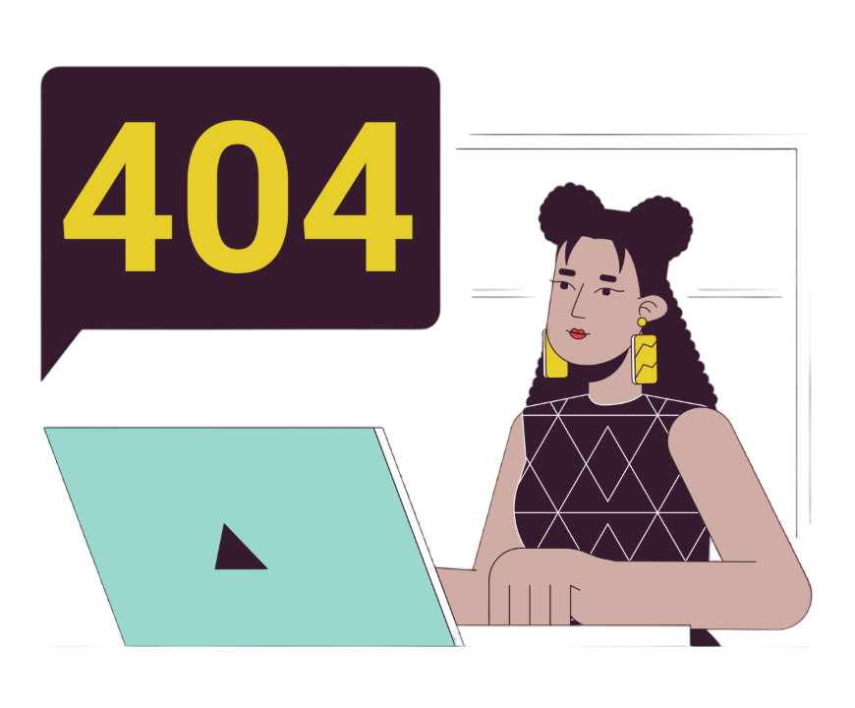
Understanding the Feeling:
Discuss how encountering errors can sometimes lead to feelings of inadequacy or inferiority, especially for beginners.
Inferiority Compex

Slide 18


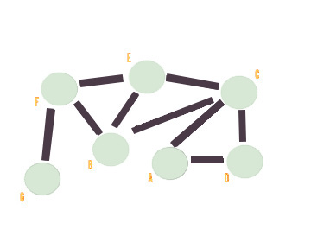






Approaching for Code:
4.
How I Started learning
2.
Code:
3.
Follow coding best practices: clear variable names, comments, and consistent formatting.
1.
Logical thinking
Identify key objectives and constraints.
Selecting Data
Structure & Algorithm
Understanding the problem
Identify key objectives and constraints.
Identify key objectives and constraints.
3.
2.
Try Solving error:
Accepted output
Straight to Coding:
IF no Error

Slide 19
WEB
EXPLORING
DATA
M.L.
APP

Slide 20


APP
App
Coding
Host
Available
User

Slide 21


3YEARS
App
Coding
Available
FRAMEWORK
A framework consists of reusable software components that provide a foundation for developing applications.
6 MONTHS
App
Dart Coding
Flutter
Available

Slide 22



WHAT IS KOTLIN?
HIGHLY COMPATIBLE WITH JAVA
SEAMLESS INTEGRATION WITH ANDROID STUDIO
METURE LANGUAGE AND ENVIRONMENT
Market yourself:
1) LINKEDIN
quickly and communicate who you are, what you do, and what sets you apart.

Slide 23

Market yourself:
1) LINKEDIN
quickly and communicate who you are, what you do, and what sets you apart.
2) GITHUB
You can share information about yourself with the community on GitHub by creating a profile README.

Slide 24
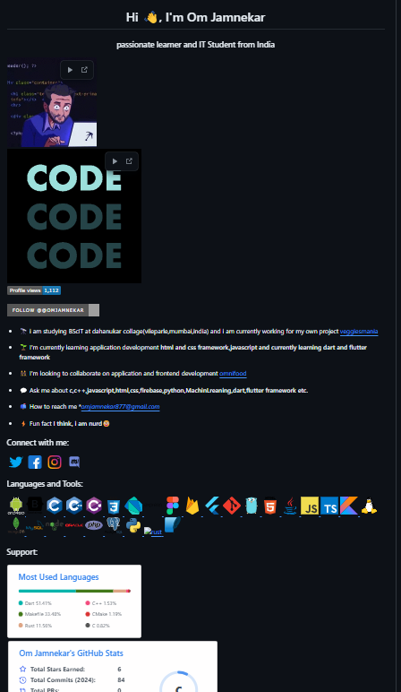
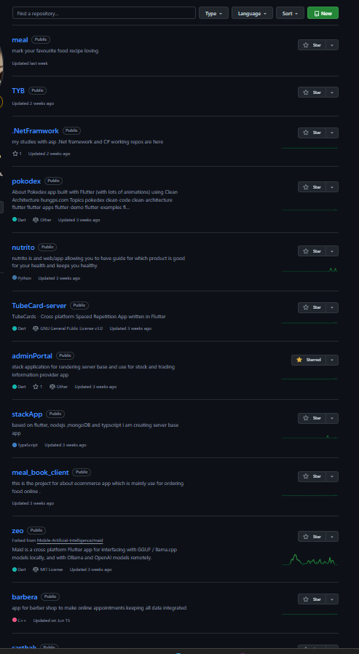
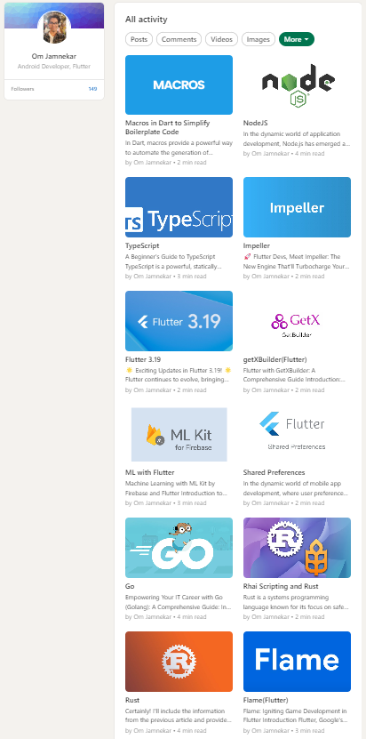
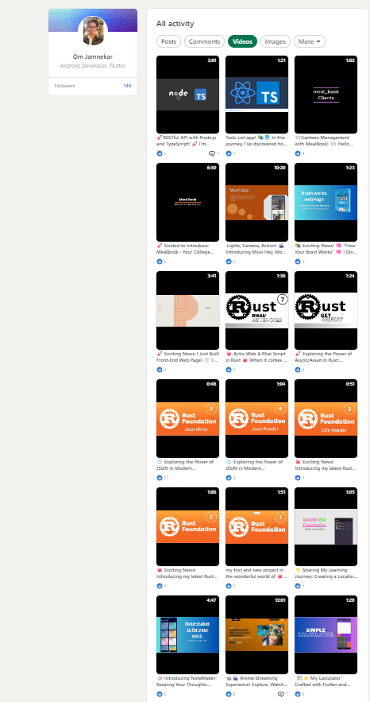
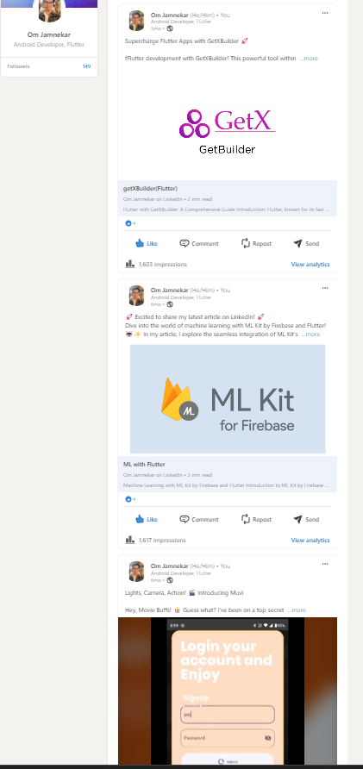
Market yourself:
GitHub:
LinkedIn:
article
Video(projects)
posts
1) LINKEDIN
quickly and communicate who you are, what you do, and what sets you apart.
PROFILE
2) GITHUB
PROJECTS
(REPOS)
You can share information about yourself with the community on GitHub by creating a profile README.

Slide 25
article
Video(projects)
posts
LinkedIn:
GITHUB:
PROFILE
PROJECTS
(REPOS)

